Slide 1

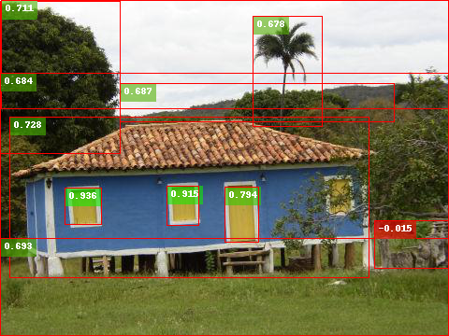
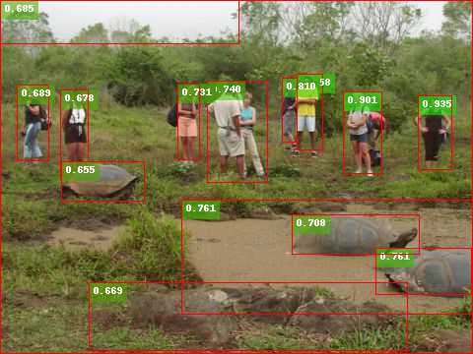
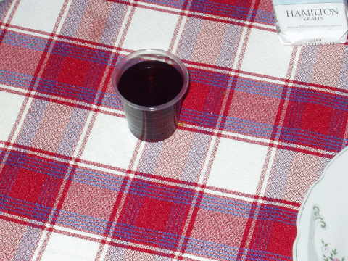
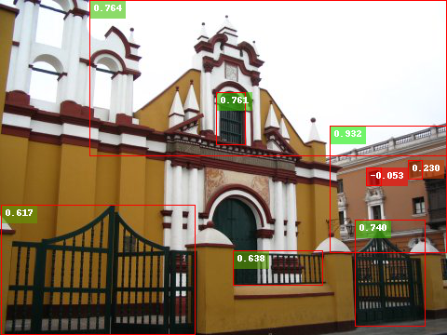
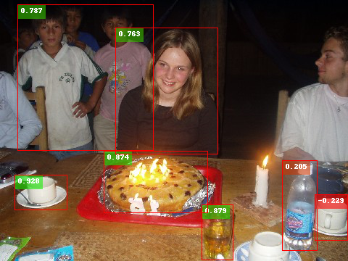
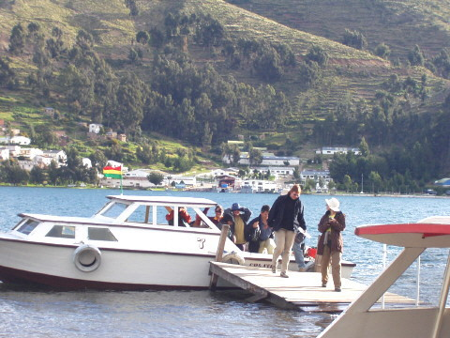
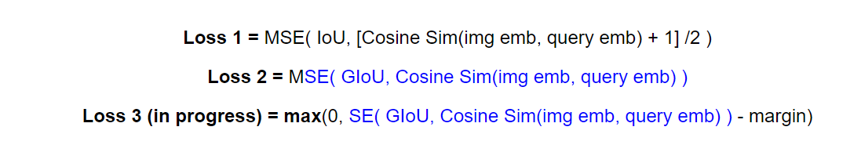
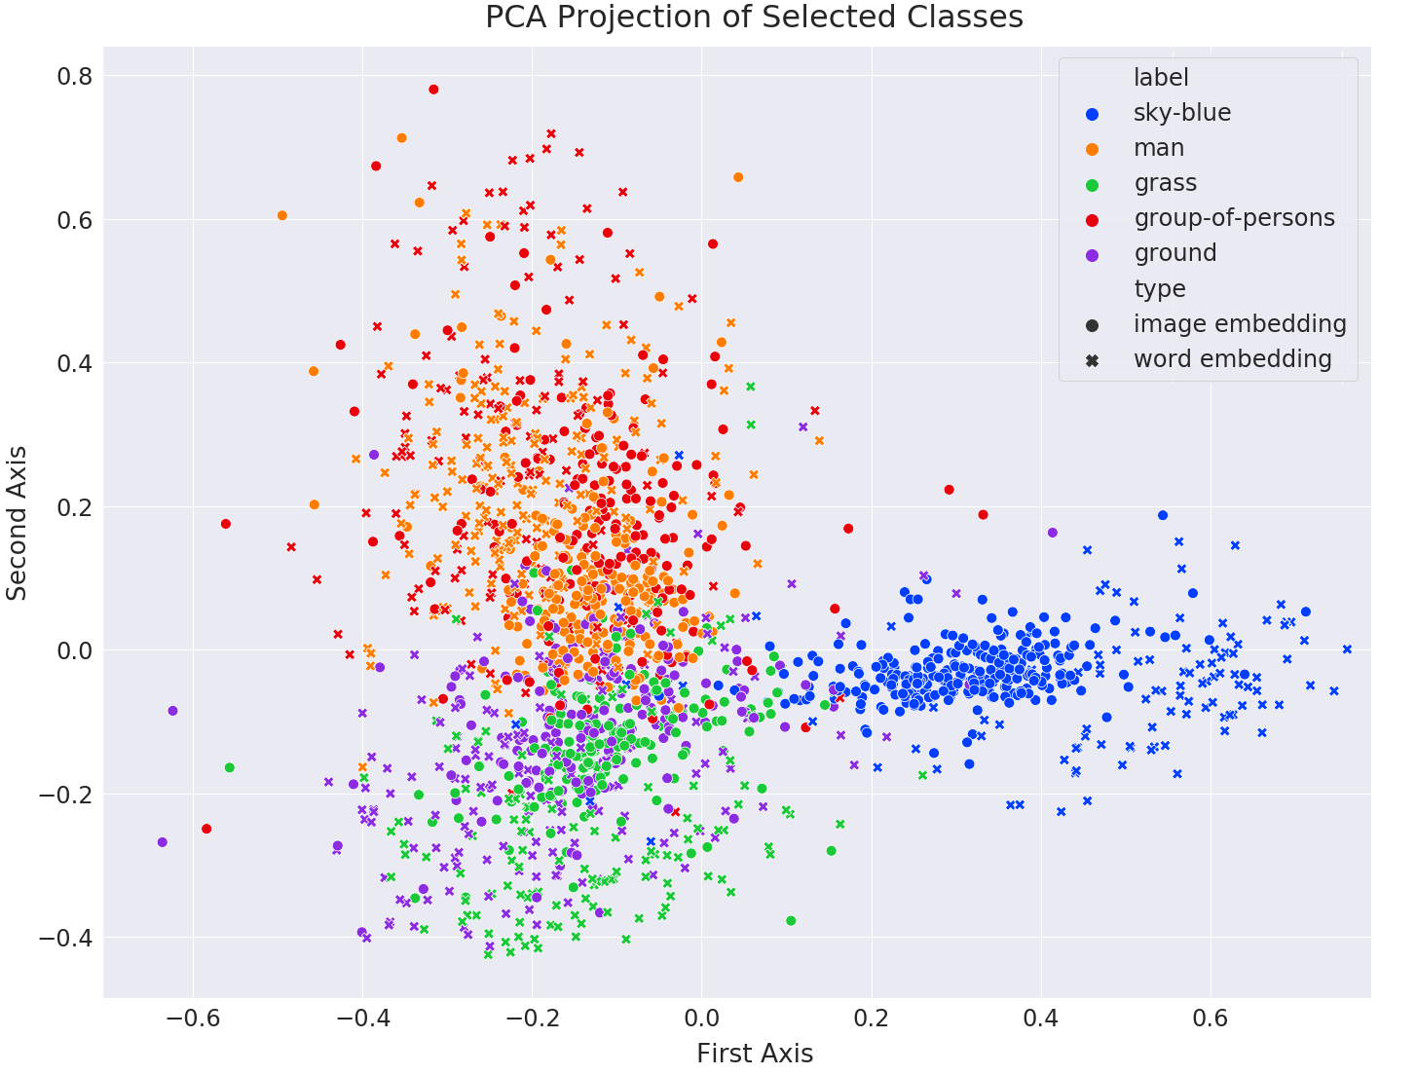
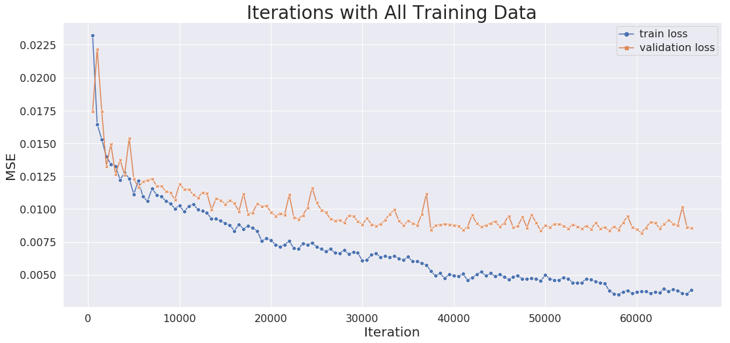

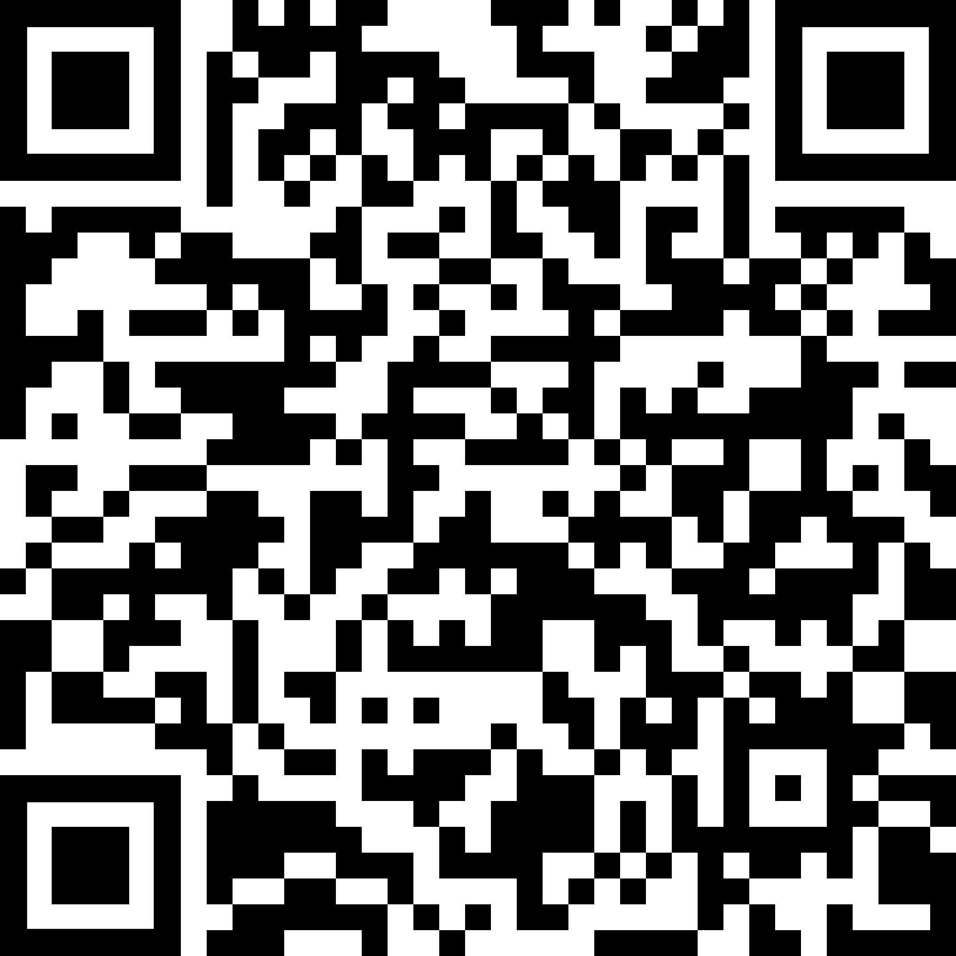
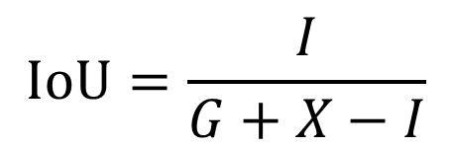
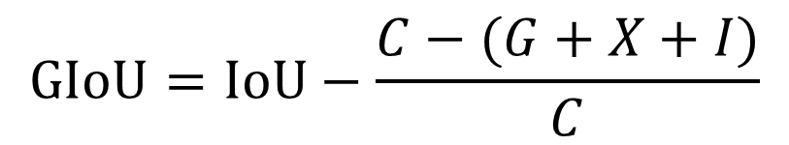
Object Localization via Natural Language Expression Alp Aribal Hakan Sirin
Technical University of Munich
Department of Informatics
Advanced Deep Learning for Computer Vision
Summer 2019
What is the problem?
Take an image and a description, then locate the described object in the image
The Model
Our model generates two embeddings that live in the same space, one coming from the image domain and the other from the expression domain.
The expression that described the sought object is first encoded using Google Universal Sentence Encoder. The output is fed to layers of fully connected nets. After normalization, the vector is called the query embedding.
In the image domain, both the full image and the image inside the candidate bounding box are fed to VGG-16 layers. The size of the extracted features are then reduced using 1x1 convolutions. After concatenating the features of the full image and box image, box coordinates are also added to the vector. Several fully connected layers follow. At the end, the vector is normalized. The resulting vector is called the image embedding.
The similarity of these two embeddings is forced using cosine distance.
Results
+
“cup of drink”
=
How does the model work?
Rather than directly predicting an object mask, we follow a two-phased approach where
We first generate candidate boxes in the image
We score each candidate and predict the one with the highest score
Google Embedding (512)
FC Layer
FC Layer
Expression Embedding (512)
“yellow window left side”
“person farthest right”
ReLU
Tanh
Length Norm.
Bbox1
0.740
Box Coords (4)
Cosine Distance
Bbox4
Bbox2
0.613
-0.137
Bbox3
Bbox5
0.245
0.811
Box Image
VGG-16
1x1 Conv
(512 to 64)
FC Layer
FC Layer
FC Layer
Bbox6
0.446
Concat (64x7x7x2)
Concat (1020 + 4)
ReLU
Tanh
Length Norm.
Image Embedding (512)
+
Bbox7
0.973
Full Image
VGG-16
1x1 Conv
(512 to 64)
“one with the white hat”
How correct is the candidate box?
Intersection over Union (IoU) is the first metric of choice to estimate how close two bounding boxes are. In our model, we use Generalized Intersection over Union (GIoU), which is an improvement on IoU, to calculate the similarity between candidate boxed and the ground truth boxes.
Loss
After experimenting with different loss functions, we ended up using a hinge loss on the squared error between the GIoU of the ground truth and candidate box and cosine similarity of the embeddings.
“building right”
“cup left center”
$Loss=max⁡\{0, SE\left(GIoU, CosSim\left(ImgEmbed, QueryEmbed\right)\right)−margin$}
G
C
$$IoU=\frac{I}{G+X−I}$$
I
X
$$GIoU=IoU−\frac{C−(G+X+I)}{C}$$
GIoU is everywhere differentiable and its range, [-1,1], is the same as cosine similarity.
Check out our repo!

